Slide 1
Meeting PRIN «Cognitive Modes, Social Motives and Prosocial Behavior» The role of anthropomorphism for social preferences. An experiment in virtual reality 20 maggio 2021

Slide 2
Exp 1. Voice in social interaction with non-human agents

Slide 3
Motivation
Behavior and decision-making interpersonal interaction in private as well as in business/economic contexts quite often is influenced by expectations
Expectations are very often shaped by social and environmental influence, i.e., social norms and preferences
Social norms e.g., are
Fairness
Reciprocity
Inequality aversion
Cooperation
…Interaktion immer häufiger mit non-human agents
How do social norms/preferences influence decision making in interactions with computer agents?

Slide 4
Fairness und das Ultimatum game
Thaler (1988) describes the Ultimatum Game as “anomaly”.
(Game) Theoretic prediction w/ rational agents:
smallest possible share is offered by the proposer and accepted by the responder.
Empirical observation:
Human players usually prefer fair splits
Unfair offers (e.g., 1, 2, or 3 out of 10) are usually rejected even if this implies losses (cf. Roth, 1995)
1
2
3
or
0
0

Slide 5
General reaction/behavior when interacting with voice interfaces
Voice User Interfaces (VUIs) are becoming more and more available, being embedded both into everyday mobility via smartphones, and into the life of the home via ‘assistant’ devices. Porcheron et al. (2018) show that those devices are embedded in daily life using following methods: addressing the device in turns-at-talk, and dealing with responses from the device.

Slide 6
Anthropomorphism
Anthropomorphism is the “tendency to imbue the real or imagined behavior of nonhuman agents
with humanlike characteristics, motivations, intentions, or emotions”. Anthropomorphism is very variable, the theory of Epley, Waytz, & Cacioppo (2007) wants to explain this. They state that three psychological variables can influence when people are likely to anthropomorphize and when not.
Accesibility and applicability of anthropocentric knowledge (cognitive determinant)
Knowledge about humans or the self in general (e.g. Characteristics, qualities) serves as a basis for induction. Knowledge about “nonhumans” can interfere with this process of conclusion and judgement.
2. Motivation to explain and understand the behavior of other agents (motivational determinant)
This means the need a person has to interact with the world in an effective way – in this case: with nonhuman agents. Attributing human features to them can help understand their actions and increase the belief to be able to predict future actions.
3. Desire for social contact and affiliation (motivational determinant)
This describes the drive to build social connections with humans – anthropomorphism can satisfy this desire, because nonhuman agents can provide (perceived) social interactions.
The theory predicts that people are more likely to anthropomorphize when anthropocentric knowledge is accessible and applicable, when motivated to be effective social agents, and when lacking a sense of social connection to other humans.

Slide 7
Anthropomorphism (cont.)
Złotowski et al. (2015) mention the theory of Epley, Waytz, & Cacioppo (2007) in the context of Human-Robot-Interaction (HRI).
There are some influential factors for human-likeness of robots.
Robot characteristics:
External appearance: Tendency, to give robots two cameras, two microphones and legs instead of wheels in the assumption this will make HRI easier
Robots that show typical human behavior (e.g. cheating)
Intelligence, predictability, perceived ‘emotions’, verbal vs. non-verbal communication
Autonomy, imitation, intrinsic moral value, moral accountability, privacy, reciprocity
Observer charatersitics:
Motivation
Social background
Gender
Age
Furthermore the “social relationship” between robot and human is important (e.g. ingroup vs. outgroup robots). The mere interaction can lead to increased anthropomorphization.

Slide 8
Ultimatum game
General overview
Thaler (1988) describes the Ultimatum Game as “anomaly”, as empirical results can hardly be described with help of theories basing on rationality. This contradicts the beliefs in economics that most behavior can be explained by rational choices and preferences. Therefore, a lot of mechanism need to be researched empirically as they cannot be fully explained by a paradigm.

Slide 9
Ultimatum game (cont.)
Human vs. Non-human interaction
An experiment of Blount (1995) shows that if human actions are associated with intentionality, especially in the ultimatum game, a disutility can result. So do differences in beliefs about the motivation behind (human) action. Human interventions and perceptions of intentionality cause additional cognitions associated with distributive and procedural justice.
Sanfey et al. (2003) researched brain activity in receivers during the Ultimatum Game. Unfair offers in the Ultimatum Game related to brain activity in regions connected to emotion and cognition. It is suggested that emotion has an important role for decision-making.
Van’t Wout et al. (2006) conducted a study comparable to the experiment by Sanfrey et al., but with skin conductance instead of brain activity as researched variable. The results revealed that skin conductance activity was higher for unfair oﬀers and was associated with the rejection of unfair oﬀers in the Ultimatum Game, but only for offers proposed by human and not offers generated by computers. These results imply that, similar to Sanfrey et al., the emotional state of receivers has a role in the Ultimatum Game, but only in interaction with humans.

Slide 10
Ultimatum game (cont.)
Human/Human vs. Human/Human-like Computer [vs. Human/Computer] interaction
In a study by Torta et al. (2015), different levels of anthropomorphism were represented in human vs. robot vs. computer proposers, which were all introduced through pictures. Rejection scores were higher in the case of a computer opponent than in the case of a human or robotic opponent. Decision time analysis also implies participants have more diﬃculties to reply to oﬀers made by a computer than to oﬀers made by robots or humans.
In a study by Swiderska et al. (2019) participants received offers from either computer agents (introduced with picture of artificial looking human) vs. “regular computers” (introduced with picture of computer). As the offers became less fair, the acceptance rates decreased for both the offers generated by the agents and the regular computer. The unfair offers made by the agents were accepted less often compared to the unfair offers from the regular computer. Therefore, on the behavioral level, participants seemed to differentiate between the two types of the proposers.

Slide 11
Voice in social interactions
An evaluation by Heblich et al. (2015) of different accents of opponents in an economically relevant context shows that linguistic performance is strongly connected to the cognitive rating of the opponent. The findings also demonstrate that cooperation is chosen more often over competition if the opponent has an accent from the home region of the participant. The accent of a voice therefore influences economic decisions.
AlHabsi & AlKahala (2018, working Paper) show that hearing a voice increases trust between strangers and that increased trust also depends on the vocal attributes of the counterpart: Voices that sound less hoarse and more harmonious decrease trust, whereas indications of murmurs and breathiness increase trust.

Slide 12
Research question and Hypotheses
Research question
How does anthropomorphism/human characteristics change social preferences and our behaviour in interaction with machines?
Hypotheses
Interaction with computers in the ultimatum game increases the acceptance rate of unfair offers
Hence,when offer is transmitted via voice, rejection rates are higher compared to interaction with ”ordinary” computer agents
The transmition of offers with the voice increases rejection rates in interaciton with humans compared to interaction without voice

Slide 13
Design and experimental procedure

Slide 14
Design
Standard Ultimatum Game
We focus on effect of computer with human characteristics on proposer side (IV) on accaptance rate (DV)
Parameterization: Endowment = 10, Proposal = integer from 0 to 10
8 rounds with rematching (perfect stranger)
2x2 design
Factor 1 = Proposer: human vs. computer proposer
Factor 2 = Format: text vs. voice message
In human treatments
Random assignment of role to player in first stage. Same role through whole experiment
Random matching after each round, perfect stranger matching
In computer treatments
we use pre-defined set of offers, randomized for each player
offers are 50%, 30%, 20% and 10%, each offered twice

Slide 15
Design (cont.)
In voice treatments
we use pre-recorded voice messages from 8 different speakers (one speaker per round) which indicate/emphasize that interaction partner changes in each round
randomize male or female voice to controll for gender effects
Conduction
in the Lab at the University of Hamburg and the Market Decision Lab at UP, using oTree (Chen, Schonger & Wickens, 2016)
Incentive:
each round will be paid
Exchange rate: 1 ECU = € 0.3
Show-up fee: € 5

Slide 16
Procedure
T0: HT
T1: HV
T2: CT
T3: CV
Welcome
Instructions
P & R: Info on role
P & R: Info on role
R: Info on role/partner type
R: Info on role/partner type
Repeat for 8 rounds
Matching with human partner or computer choice
P & R: Info on opponent
P & R: Info on opponent
R: Info on opponent
R: Info on opponent
P: offer, R: wait
P: offer, R: wait
R: wait
R: wait
Matching speaker
P: wait
R: Read text / accept screen
P: wait
R: Hear voice / accept screen
R: Read text / accept screen
R: Hear voice / accept screen
Results (& Payoff in last round)
Scales

Slide 17
Descriptives and Results

Slide 18
Sample
Conducted at University of Hamburg. Recruited using hroot (Bock, Baetge & Nicklisch, 2014), all students, all fields of study
N = 224
Age: M=26.09, SD=6.32, Min=17, Max=60
Gender: 87 male, 135 female, 2 divers/preferred not to answer
Show-up fee: € 5
Payoffs Ultimatum Game only: M = 8.48, SD = 2.78, Min = 1.5, Max = 14.4

Slide 19
Descriptives: Offers
Offers: Descriptive statistics by treatment
Offers: Relative frequencies by treatment
 | M | SD | Min | Max
overall | 4.15 | 1.02 | 0 | 8
HT | 3.94 | 1.15 | 0 | 8
HV | 4.34 | 0.86 | 1 | 6
CT and CV | 2.75 | 1.45 | 1 | 5
 | Offer
 | 0 | 1 | 2 | 3 | 4 | 5 | 6 | 7 | 8
CT | 0 | 0.25 | 0.25 | 0.25 | 0 | 0.25 | 0 | 0 | 0
CV | 0 | 0.25 | 0.25 | 0.25 | 0 | 0.25 | 0 | 0 | 0
HT | 0.01 | 0.05 | 0.05 | 0.13 | 0.44 | 0.31 | <0.01 | <0.01 | <0.01
HV | 0 | 0.01 | 0.04 | 0.09 | 0.35 | 0.51 | 0.01 | 0 | 0
Averge offer made by humans are higher than the pre-defined offers by computer agent
→ Implies higher share of fair offers
On Average, 82% of human offers are fair (>3)

Slide 20
Descriptives: Acceptance
Acceptance rate: Descriptive statistics by treatment
Acceptance rate by offer and treatment
 | acceptance | accepted offer
 | rate
 |  | M | SD | Min | Max
overall | 0.81 | 3.72 | 1.35 | 1 | 8
HT | 0.79 | 4.28 | 0.84 | 1 | 8
HV | 0.87 | 4.52 | 0.67 | 2 | 6
CT | 0.75 | 3.14 | 1.46 | 1 | 5
CV | 0.83 | 3.2 | 1.46 | 1 | 5
 | Share of Accepted Offers
 | 0 | 1 | 2 | 3 | 4 | 5 | 6 | 7 | 8
CT | - | 0.44 | 0.69 | 0.87 | - | 1 | - | - | -
CV | - | 0.56 | 0.82 | 0.95 | - | 1 | - | - | -
HT | 0 | 0.08 | 0.46 | 0.53 | 0.85 | 1 | 1 | 1 | 1
HV | - | 0 | 0.45 | 0.35 | 0.89 | 0.99 | 1 | - | -
Similar accaptance rates across treatments
Acceptance rates for offers <3 seems to be higher when made by a computer agent

Slide 21
Effect of Agent
Human vs. Computer (Text)
Human vs. Computer (Voice)
 | Human |  | Computer
 | Text |  | Text
Share of offers accepted | 0.79 | n.s. | 0.75 | T-Test
Share of accepted unfair offers | 0.37 | *** | 0.67 | T-Test
*** p<0.01, ** p<0.05, *p<0.1
 | Human |  | Computer
 | Voice |  | Voice
Share of offers accepted | 0.87 | n.s. | 0.83 | T-Test
Share of accepted unfair offers | 0.36 | *** | 0.78 | T-Test
*** p<0.01, ** p<0.05, *p<0.1
When interacting with computer rejection rates are significantly lower
Difference in acceptance rate between human and computer agent higher with voice (Note: number of unfair offers in human treatment lower)

Slide 22
Effect of Voice
Text vs. Voice (Computer)
Text vs. Voice (Human)
 | Computer |  | Computer
 | Text |  | Voice
Share of offers accepted | 0.75 | * | 0.83 | T-Test
Share of accepted unfair offers | 0.67 | * | 0.78 | T-Test
*** p<0.01, ** p<0.05, *p<0.1
 | Human |  | Human
 | Text |  | Voice
Share of offers accepted | 0.79 | * | 0.87 | T-Test
Share of accepted unfair offers | 0.37 | n.s. | 0.36 | T-Test
*** p<0.01, ** p<0.05, *p<0.1
When transmitting offer via voice, rejection rates decreases significantly when interacting with computer
No effect when interacting with a human

Slide 23
Multivariate Analysis – random-effects logistic regression
 | Acceptance rate
 | all offers |  | unfair offers
(Intercept) | -3.413 | *
Treatment: Computer - Voice | 1.37616 | * | 1.38201 | *
Treatment: Human - Text | -2.67681 | ** | -2.15996 | *
Treatment: Human - Voice | -2.38148 | * | -2.42677 | *
round | 0.15906 | ** | 0.24387 | ***
offer | 2.36302 | *** | 2.13999 | ***
unfair offer (0: offer >3, 1: offer<=3) | -1.24536 | *
age | -0.07264 | * | -0.09462 | .
gender (0: male, 1: female) | 0.9836 | . | 1.03197 | .
Perception Anthropomorphism (mean) | -0.46525 | . | -0.565 | .
Perception responsibility for action (mean) | 0.20695 |  | 0.24762
sigma | 3.690 | *** | 3.612 | ***
N | 224 |  | 224
Groups | 8 |  | 1-6
AIC | 685.2 |  | 531.8
*** p<0.001, ** p<0.01, * p<0.05, . p<0.1
The higher the round, the higher the acceptance probability
The higher the offer, the higher the acceptance probability
Unfair offers are more likely rejected
(Unfair) offers made by computers and transmitted via voice are more likely accepted
(Unfair) offers made by human agents are less likely accepted

Slide 24
Excourse: Perception of humanness (anthropomorphism scale)
 | Anthropomorphism scale
 | M | SD
HT | 5 | 0.92
HV | 4.99 | 1.35
CT | 2.34 | 1.37
CV | 2.47 | 1.62
Transmission mechanism, i.e., voice does not change perception of humanness, neither for human nor for computer opponents
Humans are perceived more human independent of the transmission mechanism

Slide 25
Conclusion

Slide 26
Conclusions … so far
Effects of agent type:
When interacting with a computer agent, acceptance rate of unfair offers increases significantly
The difference is even higher, when the offer is transmitted via voice
Effects of voice:
Acceptance rate in voice treatments is higher for both interaction with computer and humans
When interacting with a computer agent, transmission of the offer via voice also increases the acceptance rate for unfair offers
In interaction with humans the higher overall acceptance rate in the voice treatment is most likely caused by higher offers in this treatment

Slide 27
Follow-up study: Voice and VR

Slide 28
Research question and Hypotheses
Research questions
Effect of embodyment; how does acceptance behavior compared to the previous study change when
a human proposer is emobdied in VR by an avatar, and
a computer proposer is embodied in VR by an avatar?
Does an offer transmitted via voice change acceptance behavior when the proposer is emboidied in VR by an avatar?

Slide 29
Design
Standard Ultimatum Game
We focus on the effect of interaction with a computer proposer showing human characteristics, i.e., virtual body using VR and voice
Parameterization: Endowment = 10 experimental points, Proposal = integer from 0 to 10
8 rounds with rematching (perfect stranger, induced via framing)
2x2 factorial design
Factor 1 = emobdiement: encounter a computer agent in a standard desktop setting vs. in VR using an avatar
Factor 2 = transmission: offer is transmitted via text message vs. voice message
Treatments
T0 Desktop with text offer
T1 Desktop with voice offer
T2 VR with text offer
T3 VR with voice offer

Slide 30
Design (cont.)
Pre-defined offers
we use pre-defined set of offers, in randomized order
offers are 5, 3, 2 and 1, each offered twice
VR Avatars
four different avatars will be created, 2 male and 2 female, and are randomly matched to subjects
One subject encounters only one avatar throughout the eight rounds
In the voice treatments, each avatar has a unique voice
In voice treatments
we use pre-recorded voice messages from 4 different speakers (2 female, 2 male; one for each avatar)
randomize male or female voice to controll for gender effects

Slide 31
Design (cont.)
Conduction
Laboratory of Virtual Reality of the University of Siena (LabVR UNISI)
Later, in the Market Decision Labs in Nuremberg, Germany, and Pretoria, South Africa
Incentive:
each round will be paid max. 22 points
Exchange rate: 1 ECU = € 0.4 max. € 8.8
Show-up fee: € 4 max. € 12.8
Sample
N = 30-35 per treatment → N = 120-140 in total
Gender distribution per treatment ~ 50% female, 50% male
Students, age 18-24

Slide 32
Procedure
T0: DT
T1: DV
T2: VRT
T3: VRV
Welcome
Instructions
Info on role
Info on role
Info on role
Info on role
Repeat for 8 rounds
Matching Avatar
Matching Avatar
Info on opponent
Info on opponent
Info on opponent
Info on opponent
wait
wait
wait
wait
Matching speaker
Matching speaker
Read text / accept screen
Hear voice / accept screen
Read text / accept screen
Hear voice / accept screen
Results (& Payoff in last round)
Questionnaire

Slide 33
Experimental setting
Proposer
(computer)
Offer
Acceptance
Responder
voice
vs.
text
yes
or
no
offer
desktop
vs.
VR
VR
voice
vs.
text
yes
or
no
offer
Picture: Bemidji State University, Attribution, https://commons.wikimedia.org/w/index.php?curid=14494369

Slide 34
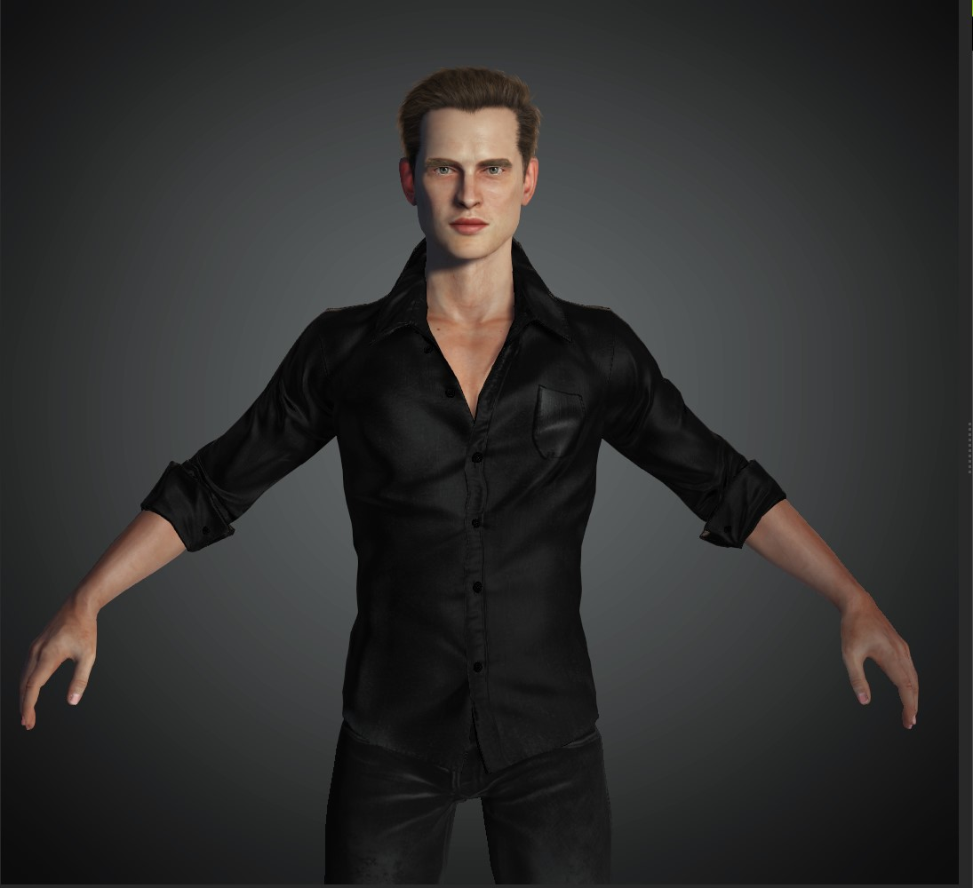
Avatars

Slide 35
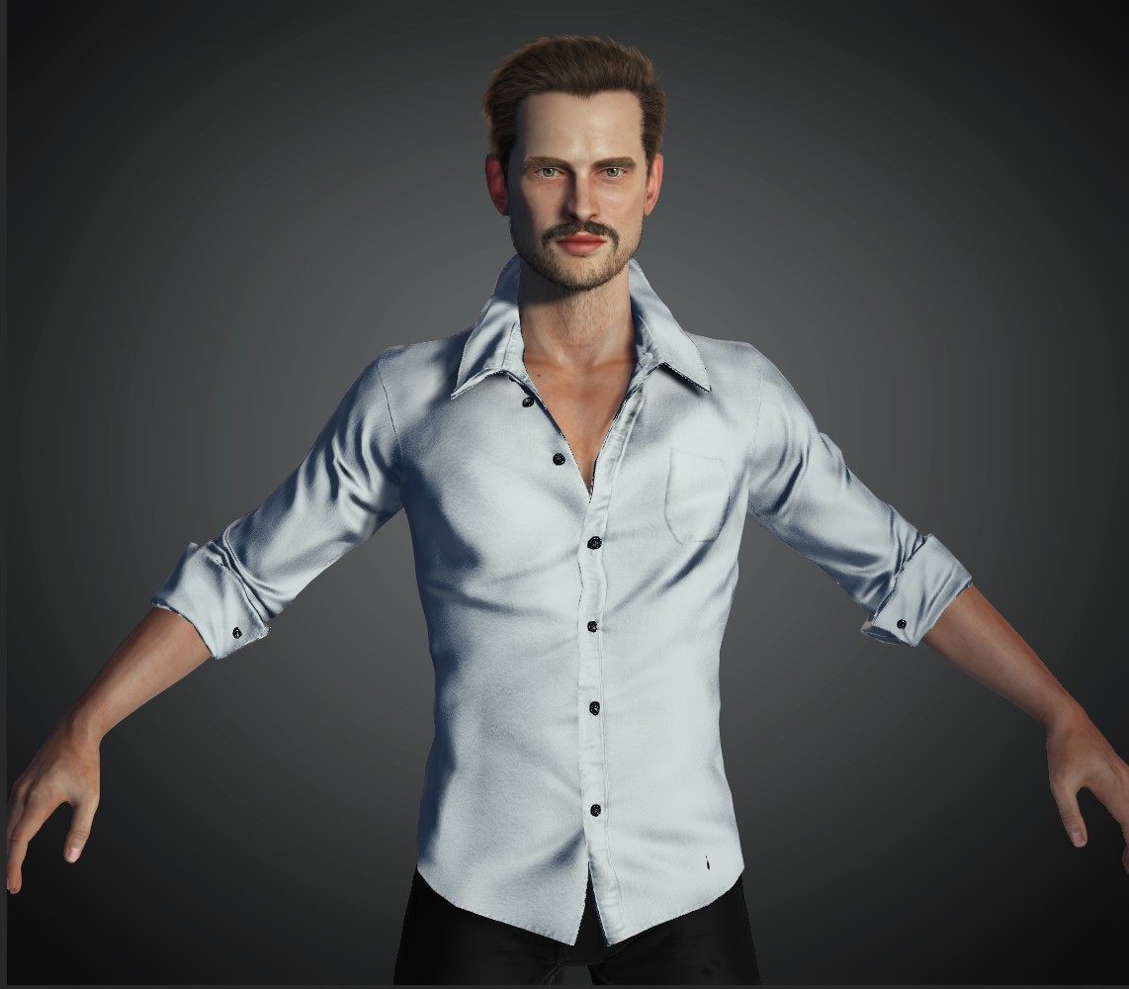
Avatars

Slide 38
Literature (cont.)
AlKahala, Y., & AlHabsi, A. (2018). Discrimination, Voice & Trust: An Experimental Approach (Doctoral dissertation).
Blount, S. (1995). When social outcomes aren't fair: The effect of causal attributions on preferences. Organizational behavior and human decision processes.
Bolton, G. E., & Ockenfels, A. (2000). ERC: A theory of equity, reciprocity, and competition. American economic review, 90(1), 166-193.
Fehr, E., & Schmidt, K. M. (1999). A theory of fairness, competition, and cooperation. The quarterly journal of economics, 114(3), 817-868.
Heblich, S., Lameli, A., & Riener, G. (2015). The effect of perceived regional accents on individual economic behavior: A lab experiment on linguistic performance, cognitive ratings and economic decisions. PloS one, 10(2).
Huber, B., & Gajos, K. Z. (2020). Conducting online virtual environment experiments with uncompensated, unsupervised samples. PloS one, 15(1), e0227629. https://doi.org/10.1371/journal.pone.0227629
Page, K. M., Nowak, M. A., & Sigmund, K. (2000). The spatial ultimatum game. Proceedings of the Royal Society of London. Series B: Biological Sciences, 267(1458), 2177-2182.
Rabin, M. (1993). Incorporating fairness into game theory and economics. The American economic review, 1281-1302.
Roth, A. E. (1995). Bargaining experiments. In: Handbook of experimental economics (ed. J. Kagel & A. E. Roth), pp. 253-348. Princeton University Press.
Sanfey, A. G., Rilling, J. K., Aronson, J. A., Nystrom, L. E., & Cohen, J. D. (2003). The neural basis of economic decision-making in the ultimatum game. Science, 300(5626), 1755-1758.
Swiderska, A., Krumhuber, E. G., & Kappas, A. (2019). Behavioral and physiological responses to computers in the ultimatum game. International Journal of Technology and Human Interaction (IJTHI), 15(1), 33-45.
Thaler, R. H. (1988). Anomalies: The ultimatum game. Journal of economic perspectives, 2(4), 195-206.
Torta, E., van Dijk, E., Ruijten, P. A., & Cuijpers, R. H. (2013, October). The ultimatum game as measurement tool for anthropomorphism in human–robot interaction. In International Conference on Social Robotics (pp. 209-217). Springer, Cham.

